Slide 1
On the Impact of the RPL Decreased Rank Attack on 6TiSCH Networks
Mohammed Mahyoub, Sazzad Hossain, and Ashraf Matrawy
Presenter: Congzhou Li

Slide 2
Abstract
The 6TiSCH protocol stack was designed to provide a reliable and time-bound multi-hop routing solution for the Industrial Internet of Things (IIoT), integrating the IPv6 Routing Protocol for Low Power and Lossy Networks (RPL) and Time-Slotted Channel Hopping (TSCH) protocols seamlessly.
However, deviations from standard procedures by malicious nodes can severely affect network formation and operations, resulting in degraded performance. This study investigates the impact of the decreased rank attack (DRA) on RPL within the 6TiSCH network, examining its effects on network operations and performance.

Slide 3
Contents
Introduction
RPL’s Relation to TSCH
Simulation Setup
Result and Discussion
Conclusion

Slide 4
Introduction
The time-slotted channel hopping protocol (TSCH) is
widely adopted as the Medium Access Control (MAC) mechanism in industrial applications. It offers predictable and deterministic communication, making it essential for realtime and mission-critical industrial applications.
TSCH protocol enhances the resilience of communication against interference by spreading communications across different time slots and frequency channels.

Slide 5
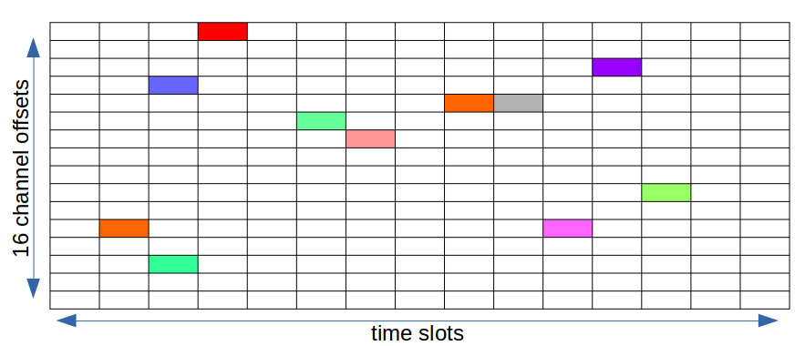
Introduction
TSCH is used by Low-Power devices to communicate using a wireless link. It is designed for low-power and lossy networks (LLNs) and aims at providing a reliable Media access control layer.
TSCH can be seen as a combination of Time division multiple access (TDMA) and Frequency-division multiple access (FDMA) mechanisms as it uses diversity in time and frequency to provide reliability to the upper network layers.

Slide 6
Introduction
The 6TiSCH stack (IPv6 over TSCH mode of IEEE 802.15.4e), which is based on TSCH, encompasses the management of a distributed communication schedule that continuously adapts to network changes.
The 6TiSCH Working Group established mechanisms for seamless integration of the IPv6 Routing Protocol for Low Power and Lossy Networks (RPL) to efficiently operate on the TSCH link layer protocol.
This highlights the importance of the 6TiSCH protocol stack for the Industrial Internet of Things (IIoT) as it enables reliable and energy-efficient communication between devices in industrial settings

Slide 7
Introduction
The process of forming a 6TiSCH network involves nodes gradually joining the TSCH network and executing RPL operations to gather topology information and determine the most efficient multi-hop routes for data transmission.
To establish network configuration and allocate transmission opportunities during the bootstrap phase, 6TiSCH-MC utilizes a static resource allocation implemented by all nodes to facilitate the transmission of control messages during network formation.
To ensure smooth network operations and successful initial
topology discovery processes, it is essential to adhere to the
standard procedures of TSCH and RPL. Deviation from these
standards by malicious nodes can severely disrupt or impede
network functions

Slide 8
Introduction
DRA Explanation:
In this type of attack, the malicious node initially joins the network as a regular node, which means that it gets a legitimate rank that reflects its distance from the root. However, whenever the malicious node advertises its rank to the neighborhood, it includes a fake rank that is less than its real rank.
By presenting a lower rank, the attacker appears to be more favorable in terms of distance from the root and routing efficiency.

Slide 9
Introduction
As a result, neighboring nodes select the
attacker as their preferred parent, allowing the attacker to gain control over the routing path and influence network traffic.
This tactic allows the attacker to manipulate the behavior of the network and potentially carry out further malicious activities within the compromised network.

Slide 10
Introduction
Contribution:
Unlike CSMA, which does not rely on the routing protocol (i.e. RPL) for its operations, TSCH in the context of 6TiSCH heavily depends on the routing protocol. Therefore, it is not clear to what extent the current observations and conclusions about DRA’s impact on CSMA will apply to 6TiSCH.
This paper makes the timely contribution to investigating the impact of the DRA that specifically targets the RPL protocol to analyze its effect on 6TiSCH networks.

Slide 11
RPL’s Relation to TSCH
TSCH Shared Cell:
TSCH divides time into fixed-length intervals known as slot frames. Each slot frame consists of multiple timeslots, and within each timeslot, a node can utilize a set of available frequencies or channels. This creates a matrix-like schedule where cells represent potential communication opportunities between a node and its neighboring nodes.
In the context of 6TiSCH-MC, it is recommended to use only one cell per slot-frame, known as a minimal or shared cell. This shared cell is used to transmit control messages from both the TSCH and RPL layers.

Slide 12
RPL’s Relation to TSCH
Network Formation:
To become fully functional within the network, a new joining node, also known as a pledge, undergoes two essential steps. First, the pledge needs to establish a connection with the TSCH network, becoming a TSCH-synchronized node. This synchronization allows the
pledge to engage in direct single-hop communication with its neighboring nodes.
Subsequently, the node needs to join the logical topology of the RPL routing protocol, becoming an RPL-joined node. This step allows the node to populate its routing table and gain the ability to forward data over multiple hops, ensuring efficient and reliable data transmission across the network.

Slide 13
RPL’s Relation to TSCH
RPL and TSCH Relationship:
Once the pledge becomes a joined node, 6TiSCH-MC suggests aligning the link layer topology (TSCH) and the routing topology (RPL) by representing the Join Metric field as the RPL rank.
This alignment enables the pledge to choose a Joined Proxy (JP) close to the root of the network, increasing the likelihood that it is the preferred parent in the RPL topology as well.

Slide 14
Simulation Setup
We conducted a set of experiments to evaluate the impact of the DRA on 6TiSCH network operations and performance using the Contiki-NG2 operating system and the Cooja emulator.
The emulator comes within the Contiki NG, which creates the node with the exact configuration as real-world devices. It allows the uploading of code to work directly in real devices and performs hardware-level simulations utilizing real hardware profiles of emulated nodes

Slide 15
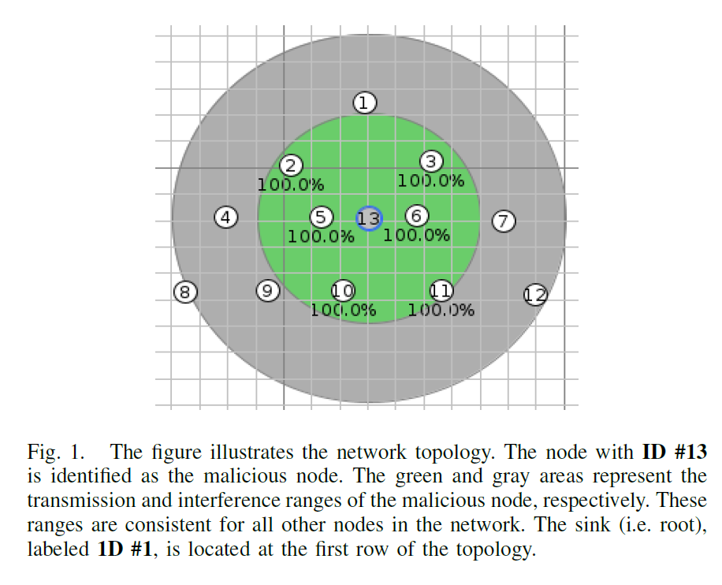
Simulation Setup
The network shown in Fig. 1 is considered for these experiments. It has a simple tree topology with 12 nodes in which Z1 motes (IoT devices) are adopted in this simulation.

Slide 16
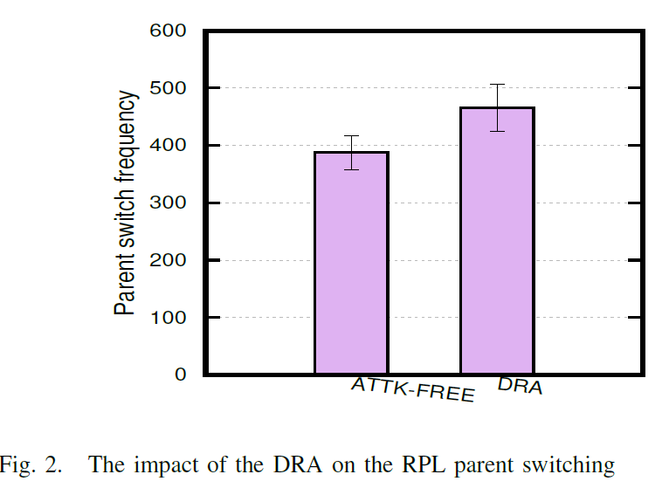
Results and Discussion
The Impact of the DRA on the Network Operations
Parent-switching and RPL control messages

Slide 17
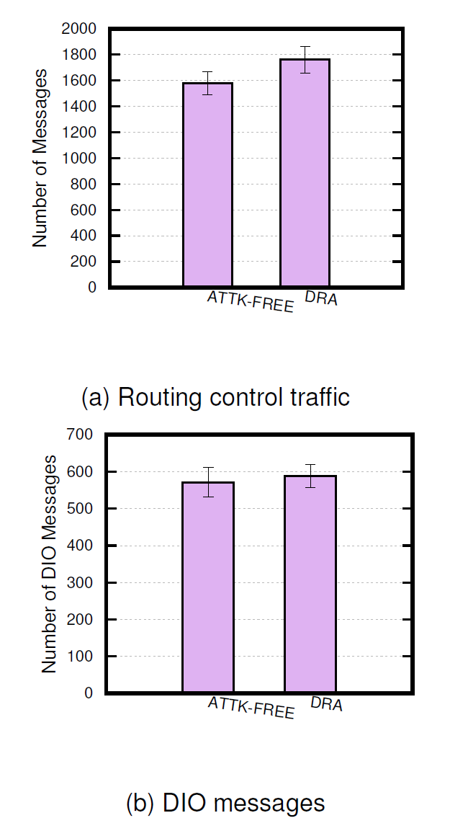
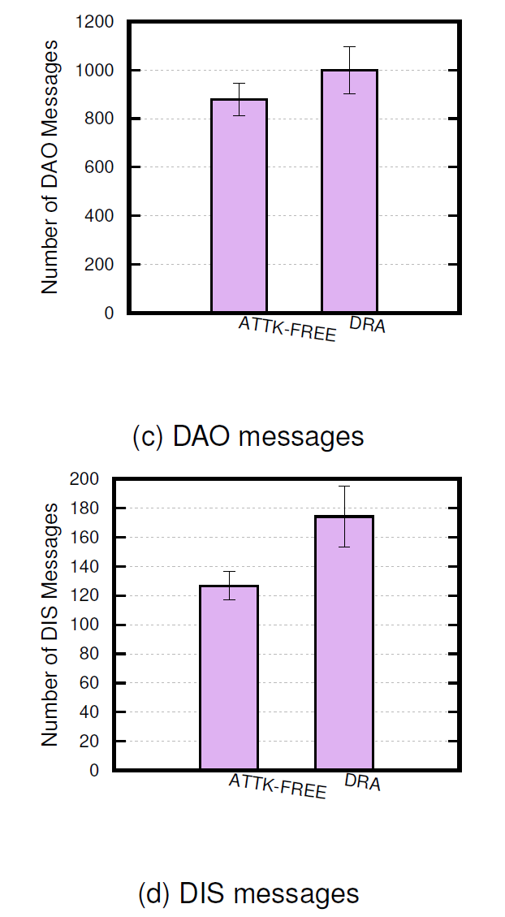
Results and Discussion
The Impact of the DRA on the Network Operations
Parent-switching and RPL control messages

Slide 18
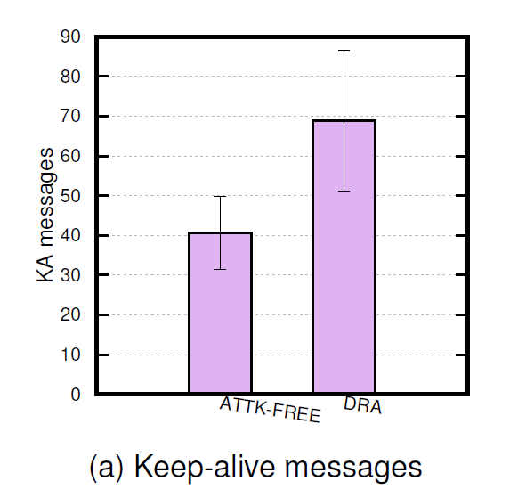
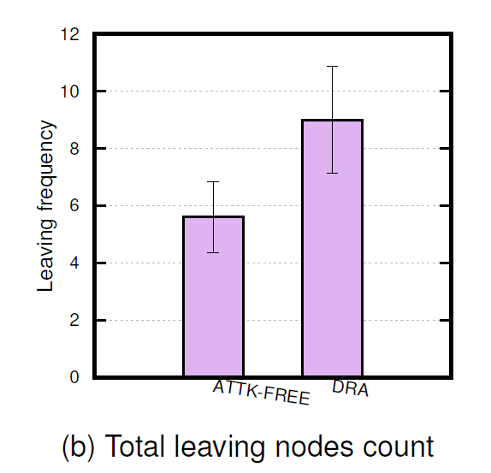

Results and Discussion
The Impact of the DRA on the Network Operations
KA messages and node departure frequency

Slide 19
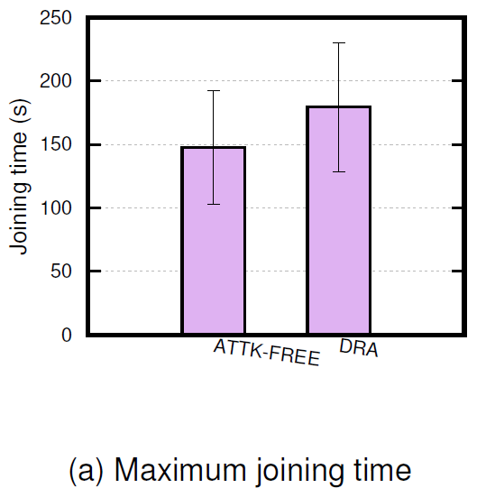
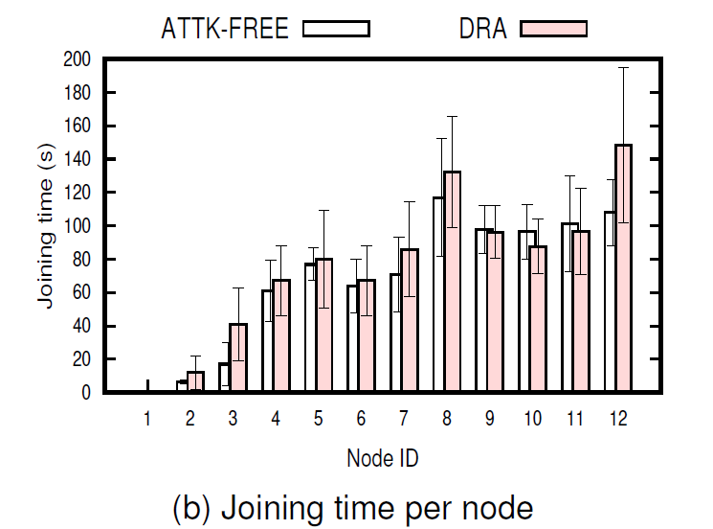
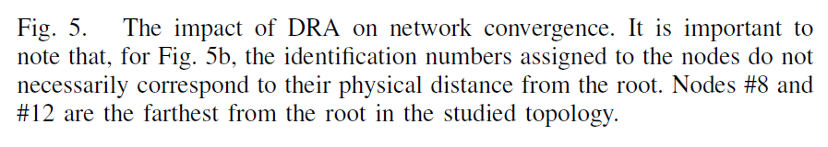
Results and Discussion
The Impact of the DRA on the Network Operations
Network convergence

Slide 20
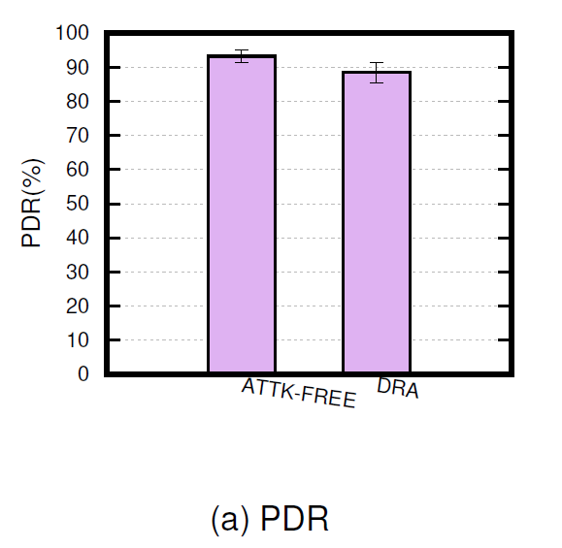
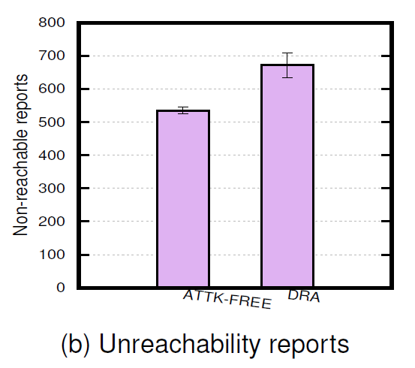
Results and Discussion
The Impact of DRA on the Network Performance
PDR and reachability

Slide 21
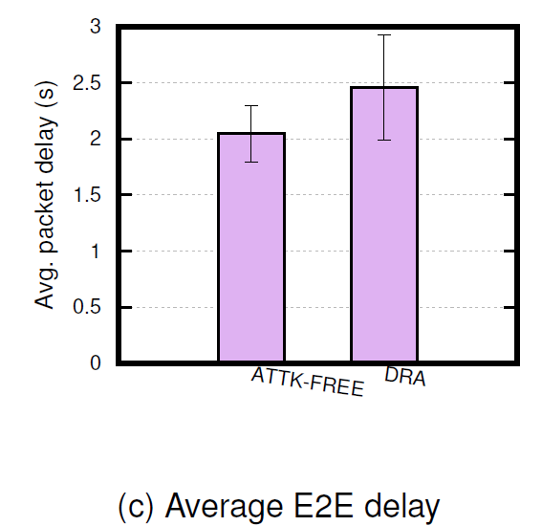
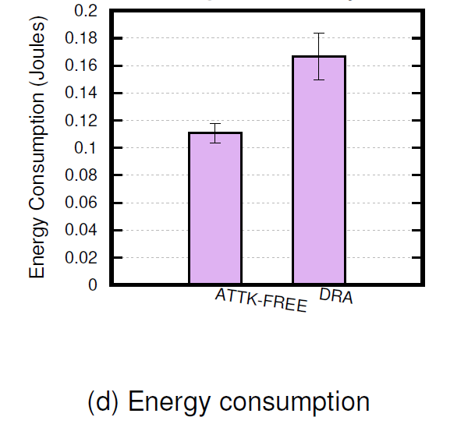
Results and Discussion
The Impact of DRA on the Network Performance
Packet E2E delay and Energy consumption

Slide 22
Conclusion
In 6TiSCH-MC, a single slot known as the shared cell is designated at the beginning of each slot frame for various control traffic exchanges. This includes enhanced beacon, keep alive, RPL control packets, Join Request, and Join Response frames.
However, under the decreased rank attack (DRA), the nodes are compelled to transmit a higher number of these frames at both the RPL and TSCH layers. As a consequence, this increased transmission results in congestion within the shared cell. As nodes compete for access to the shared cell simultaneously, it leads to contention and delays.

Slide 23
Conclusion
Our findings indicate that the DRA can significantly disrupt network formation and ongoing operations. This disruption can result in more frequent node departures due to desynchronization, as nodes try to maintain the network topology.
Furthermore, the DRA negatively impacts network reliability and increases latency. The increased transmission of keep-alive and RPL messages consumes more energy, further exacerbating the issue of increased energy consumption.

